Slide 1
Dynamic Programming
1. It break down the complex problem into simpler subproblems
2. Find optimal solution to these subproblems
3. Store these results of these problems (memorization)
4. Reuse them so that same subproblem is not calculated more than once
5. Finally calculate the result of complex problem

Slide 2
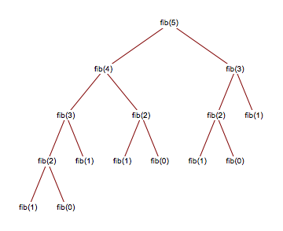
Dynamic Programming

Slide 3
int fib(int n)
{
if (n <= 1)
return n;
return fib(n-1) + fib(n-2);
}
int fib(int n)
{
Int a[];
a[0]=0, a[1]=1;
for(i=2;i<=n;i++)
{
A[i]=a[i-1]+a[i-2];
}
return a[n];
}

Slide 4
Optimal Substructure Property
A given problem is said to have Optimal Substructure Property if the optimal solution of the given problem can be obtained by using the optimal solution to its subproblems instead of trying every possible way to solve the subproblems.
Example:
The Shortest Path problem has the following optimal substructure property:
If node x lies in the shortest path from a source node U to destination node V then the shortest path from U to V is a combination of the shortest path from U to X and the shortest path from X to V
Floyd Warshall, Bellman Ford

Slide 5
Overlapping Subproblems Property
It refers to the situation where a problem can be broken down into smaller subproblems, and these subproblems are solved multiple times during the computation of the main problem. Instead of solving the same subproblems repeatedly, dynamic programming saves the results of these subproblems (usually in a table or memoization) and reuses them to save time.
example
Longest Common Subsequence (LCS)
Knapsack Problem
Edit Distance

Slide 6
Memorization (Top Down Approach): Solving problem recursively and storing the results of subprolems in a table so that they can be reused when needed. The idea is to avoid recalculating the same subproblem.
Tabulation (Bottom up Approach): Solves all problems starting from the smallest one, building up to the solution of the original problem. The subproblem solutions are stored in a table and final solution is obtained directly.

Slide 7
Tiling Problem
Given a 2*n board and tiles of size 2*1, count the number of ways to tile the given board using the 2*1 tiles. A tile can either be placed horizontally i.e. as a 1*2 tile or vertically i.e. as 2*1 tile .
Input: n=1
Output: 1
Input: n=2
Output: 2

Slide 8
Unbounded Knapsack Problem
Given a knapsack with capacity w=8 and a set of items with the following weights and values
You can pick unlimited instances of each item. Find the maximum value that can fit in the knapsack.
Item | Weight | Value
1 | 2 | 4
2 | 3 | 5
3 | 4 | 7

Slide 9
Longest Increasing Subsequence
longest subsequence of a given sequence such that all elements of the subsequence are sorted in increasing order
For example, for {10, 22, 9, 33, 21, 50, 41, 60, 80}
Subsequence: {10}, {10,22}, {10, 9, 33}, {33, 21, 60}
Increasing Subsequence: {10}, {10,22}, {10, 22, 33}, {33, 50, 60}
Longest Increasing Subsequence: {10, 22, 33, 50, 60, 80} or
{10, 22, 33, 41, 60, 80}
the length of LIS is 6

Slide 10
Longest Increasing Subsequence
arr[n]: input array
L(i): length of the LIS ending at index i such that arr[i] is the last element of the LIS.
Then, L(i) can be recursively written as:
L(i) = 1 + max( L(j) ) where 0 < j < i and arr[j] < arr[i]; or L(i) = 1, if no such j exists.
LIS for a given array is max(L(i)) where 0 < i < n.

Slide 11
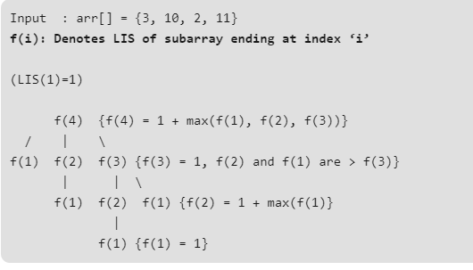

Slide 12
class LIS {
static int lis(int arr[],int n) {
int lis[] = new int[n];
int i,j,max = 0;
for ( i = 0; i < n; i++ )
lis[i] = 1;
for ( i = 1; i < n; i++ )
for ( j = 0; j < i; j++ )
if ( arr[i] > arr[j] && lis[i] < lis[j] + 1)
lis[i] = lis[j] + 1;
for ( i = 0; i < n; i++ )
if ( max < lis[i] )
max = lis[i];
return max;
}
public static void main(String args[]) {
int arr[] = { 10, 22, 9, 33, 21, 50, 41, 60 };
int n = arr.length;
System.out.println("Length of lis is " + lis( arr, n ) + "n" );
}
}

Slide 13
Complexity Analysis
Time complexity : O(n²) Two loops of n are there.
Space complexity : O(n) dp array of size n is used.

Slide 14
Longest Common Subsequence
Given two sequences, the length of longest subsequence present in both of them.
A subsequence is a sequence that appears in the same relative order, but not necessarily contiguous.
For example, “abc”, “abg”, “bdf”, “aeg”, ‘”acefg”, .. etc are subsequence of “abcdefg”.
LCS for input Sequences “ABCDGH” and “AEDFHR” is “ADH” of length 3.
LCS for input Sequences “AGGTAB” and “GXTXAYB” is “GTAB” of length 4.
A string of length n has 2^{n} different possible subsequence.

Slide 15
Longest Common Subsequence
Let the input sequences be X[m] and Y[n] of lengths m and n respectively
Let L(X[m], Y[n]) be the length of LCS of the two sequences X and Y
If last characters of both sequences match (or X[m-1] == Y[n-1]) then
L(X[0..m-1], Y[0..n-1]) = 1 + L(X[0..m-2], Y[0..n-2])
e.g. L(“AGGTAB”, “GXTXAYB”) = 1 + L(“AGGTA”, “GXTXAY”)
If last characters of both sequences do not match (or X[m-1] != Y[n-1]) then
L(X[0..m-1], Y[0..n-1]) = MAX ( L(X[0..m-2], Y[0..n-1]), L(X[0..m-1], Y[0..n-2]) )
e.g. L(“ABCDGH”, “AEDFHR”) = MAX( L(“ABCDG”, “AEDFHR”), L(“ABCDGH”, “AEDFH”) )

Slide 16
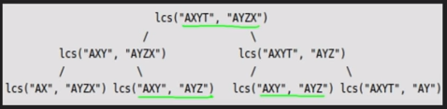

Slide 17
Longest Common Subsequence
X=ABAABA Y=BABBAB
If X[i] == Y[j]: dp[i][j] = 1 + dp[i-1][j-1] # If characters match, add 1 to the result
Else: dp[i][j] = max(dp[i][j-1], dp[i-1][j])
 | NULL | B | A | B | B | A | b
NULL | 0 | 0 | 0 | 0 | 0 | 0 | 0
A | 0
B | 0
A | 0
A | 0
B | 0
A | 0

Slide 18
Longest Increasing Subsequence
[1 4 2 5 3]=[1 2 5] [1 4 5] [1 2 3]

Slide 19
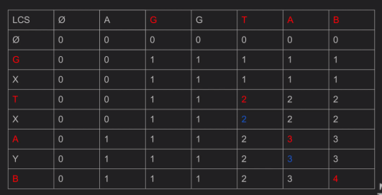

Slide 20
int lcs( char *X, char *Y, int m, int n )
{
int L[m+1][n+1];
int i, j;
for (i=0; i<=m; i++)
{
for (j=0; j<=n; j++)
{
if (i == 0 || j == 0)
L[i][j] = 0;
else if (X[i-1] == Y[j-1])
L[i][j] = L[i-1][j-1] + 1;
else
L[i][j] = max(L[i-1][j], L[i][j-1]);
}
} return L[m][n];
}

Slide 21
Partition Subset Sum
Problem Statement: Given an array a[] of size N, check if it can be partitioned into two parts such that the sum of elements in both parts is the same.
e.g. a=[6,8,10,2,3,5]

Slide 22
Edit Distance
Input : Two strings str1 and str2
Allowed Operations on str1
Insert
Remove
Replace
Assume operations are of equal cost.
Output : Find minimum number of edits (operations) required to convert ‘str1’ into ‘str2’.

Slide 23
Edit Distance
Input: str1 = "abcdef“
str2 = "akcdg"
Output: 3

Slide 24
Edit Distance
Process all characters one by one staring from either from left or right sides of both strings
Let m: Length of str1 (first string)
n: Length of str2 (second string)
If last characters of two strings are same, Ignore last characters, Count
remains unchanged and recur for lengths m-1 and n-1
else
(a) consider all three operations on last character of first string
(b) recursively compute minimum cost for all three operations
Insert: Recur for m and n-1
Remove: Recur for m-1 and n
Replace: Recur for m-1 and n-1
(c) take minimum of three values

Slide 25
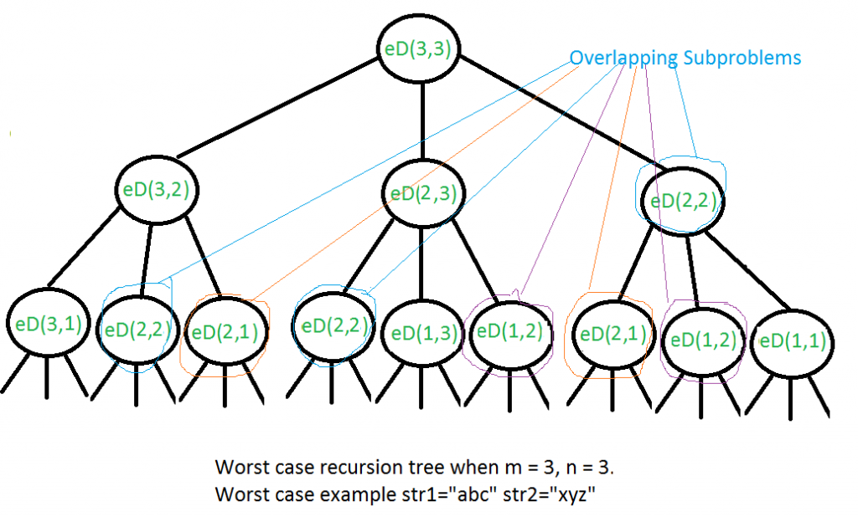

Slide 26
int editDistDP(string str1, string str2, int m, int n)
{
int dp[m+1][n+1];
for (int i=0; i<=m; i++) {
for (int j=0; j<=n; j++) {
if (i==0) // If first string is empty
dp[i][j] = j; // insert all characters of second string, Min. operations = j
else if (j==0) // If second string is empty
dp[i][j] = i; // remove all characters of second string , Min. operations = i
else if (str1[i-1] == str2[j-1])
dp[i][j] = dp[i-1][j-1];
else
dp[i][j] = 1 + min(dp[i][j-1], dp[i-1][j], dp[i-1][j-1]); // Insert, Remove and Replace
}
}
return dp[m][n];
}

Slide 27
Edit Distance to convert CART to MARCH
Str 1 = CART AND Str2 = MARCH
Compare CART to Ø and then MARCH to Ø
 | Ø | M | A | R | C | H
Ø
C
A
R
T

Slide 28
Edit Distance to convert CART to MARCH
Str 1 = CART
Str2 = MARCH
 | Ø | M | A | R | C | H
Ø | 0 | 1 | 2 | 3 | 4 | 5
C | 1 | 1 | 2 | 3 | 3 | 4
A | 2 | 2 | 1 | 2 | 3 | 4
R | 3 | 3 | 2 | 1 | 2 | 3
T | 4 | 4 | 3 | 2 | 2 | 3

Slide 29

BIONOMIAL COFFICIENTS
A binomial coefficient C(n, k) can be defined as the coefficient of X^{k} in the expansion of (1 + X)^{n}.
A binomial coefficient C(n, k) also gives the number of ways, disregarding order, that k objects can be chosen from among n objects
Or
more formally, the number of k-element subsets (or k-combinations) of an n-element set.
Mathematically, ^{n}C_{r} = n!/r!* (n-r)!

Slide 30

Pascal’s Triangle is a triangular array of the binomial coefficients.
1
1 1
1 2 1
1 3 3 1
1 4 6 4 1
1 5 10 10 5 1

Slide 31
Merge sort:

Slide 32
Sort the array based on frequency of values (Sort as per value if frequency is same)
arr={10,7,10,11,10,7,5,6}

Slide 33
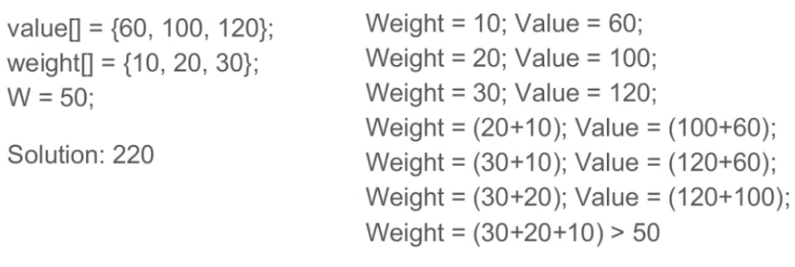
0-1 Knapsack Problem
Given weights and values of n items, put these items in a knapsack of capacity W to get the maximum total value in the knapsack

Slide 34
Method 1: Recursion.
To consider all subsets of items, there can be two cases for every item.
knapSack(W, wt, val, n)
Case 1: The item is included in the optimal subset.
Value of nth item plus maximum value obtained by n-1 items and W minus the
weight of the nth item (including nth item)
val[n - 1] + knapSack(W - wt[n - 1], wt, val, n - 1)
Case 2: The item is not included in the optimal set.
Maximum value obtained by n-1 items and W weight (excluding nth item)
knapSack(W, wt, val, n - 1)
Max

Slide 35
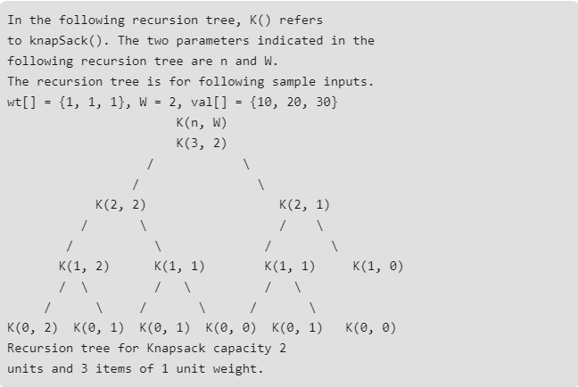

Slide 36
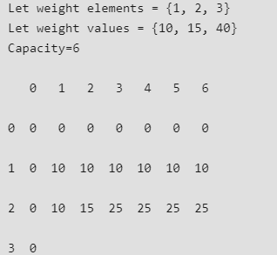
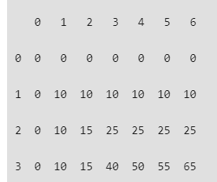
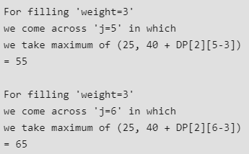

Slide 37
static int knapSack(int W, int wt[], int val[], int n) {
int i, w;
int K[][] = new int[n+1][W+1];
for (i = 0; i <= n; i++) {
for (w = 0; w <= W; w++) {
if (i==0 || w==0)
K[i][w] = 0;
else if (wt[i-1] <= w)
K[i][w] = max(val[i-1] + K[i-1][w-wt[i-1]], K[i-1][w]);
else
K[i][w] = K[i-1][w];
}
}
return K[n][W];
}

Slide 38
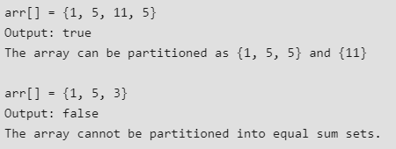
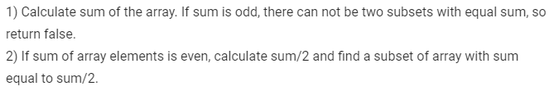
Partition Problem

Slide 39
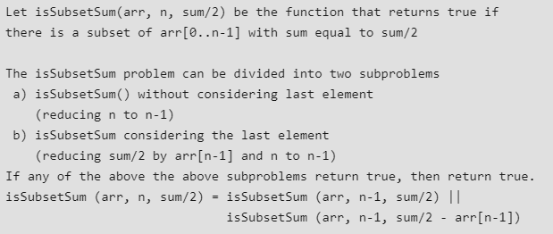

Slide 40

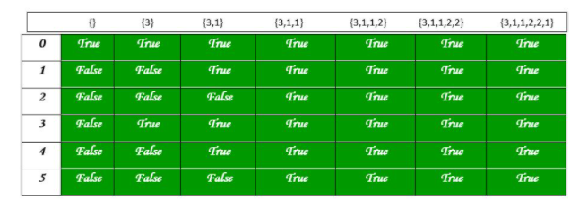

Slide 41
static boolean findPartition(int arr[], int n){
int sum = 0; int i, j;
for (i = 0; i < n; i++)
sum += arr[i];
if (sum % 2 != 0)
return false;
boolean part[][] = new boolean[sum / 2 + 1][n + 1];
for (i = 0; i <= n; i++)
part[0][i] = true;
for (i = 1; i <= sum / 2; i++)
part[i][0] = false;
for (i = 1; i <= sum / 2; i++) {
for (j = 1; j <= n; j++) {
part[i][j] = part[i][j - 1];
if (i >= arr[j - 1])
part[i][j] = part[i][j] || part[i - arr[j - 1]][j - 1];
}
}
return part[sum / 2][n];
}

